Slide 1
Software Design and Engineering

Slide 2
Programming Style Guidelines

Slide 3
Style and Management
We have been learning how to program.
Now let's talk about how to program well.
We'll look at a few very basic concepts of software design.

Slide 4
General Advice
Never hard-code literals. Not even pi. Assign to variables.
You’ll thank me the first time you have to change some fundamental constant and only have to do it once.
Try to do at least basic sanity checks on your input.
Never expect a compiler or interpreter to read your mind. If you intend something to be a float, declare it as such (if required by your language) or, for constants, put the period at the end. Use explicit casts just to be explicit.
Don’t try to be fancier than necessary. Just because you can do something doesn’t mean you have to do it.

Slide 5
Keep it Neat
Indent properly. Code at the same level should have the same indentation. Indent each level a fixed number of spaces (3 or 4 is usually good). Don’t use tabs. Python will force good indentation but do not use tabs; use spaces.
Never have repeated blocks of code. Write a function/subroutine/procedure. Avoid copy-paste errors.
Think of code as a table, or as mathematical notation. Keep your layout neat.
Line up indicators like = or (in Fortran) :: if they occur in adjacent lines and are not too different in length
Line up any continuation markers at a consistent column number (80 characters, including blanks, is still a good length for a line, and is actually part of the "official" Python style guide PEP).

Slide 6
Make Code Self-Documenting
Choose good variable names. It’s not necessary to make them extremely long, but they should be self-explanatory.
Similarly, choose good function/subroutine/procedure names. Don’t use e.g. “compute” as the name of your most important routine. Compute what? It must do something more specific.
Once again, INDENT PROPERLY!

Slide 7
Variable Names
Variable names should tend to be nouns or noun phrases except for Booleans/logicals
Boolean/logical variables should be more like adjectives or adjective phrases, e.g. Full or is_full or isFull
If a function acts like a variable, its name should be a noun or noun phrase or (if Boolean) adjectival. If it is more like a subroutine its name should be a verb or verb phrase.
Make variable names short, but not too short.
CheckIfCorrect versus Validate
Use underscores or capitalization to separate words in a variable name; don’t run words together

Slide 8
More Specific Guidelines
Routine variables such as array or loop indices should be short (i,j,k and so forth) and may be reused. Less commonly used variables, or variables corresponding to mathematical quantities, should have a longer, descriptive name. Use normal English ordering, e.g. SetName rather than NameSet.
Use spaces to show the layout. Align horizontally and vertically.
Use blank lines to separate logically distinct sections of code, but do not overuse blank lines.
http://www.eng.utoledo.edu/eecs/faculty_web/hledgard/softe/upload/index.php?
File is Professional Guidelines-2011.doc
Examples and a few of the guidelines are specific to C++, but most of the advice is of general applicability.

Slide 9
Documentation
Put a short documentation block at the top of every function/subroutine/procedure.
My personal taste: don’t document excessively. Only document lines that aren’t obvious to a casual reader (who knows the language). It’s distracting to have too many comments.
I often actually write pseudocode without commenting it out, that way it will throw a syntax error if I don’t finish so I know that it’s incomplete.

Slide 10
Example
Not so good:
import math
"""This script computes the surface area of a sphere of radius r.
The value of r is input by the user. """
#Enter radius
r = float(raw_input("Enter the radius r:"))
#Compute area
A = 4*math.pi*r**2
print "r= %10.3f A=%10.3e" % (r,A)

Slide 11
Example Improved
import math
"""This script computes the surface area of a sphere of a specified radius. The value of the radius is input by the user.
Author : Jim Dandy
Changelog: First version May 2013
"""
radius = float(raw_input("Enter the radius:"))
surf_area = 4.*math.pi*radius**2
print "radius= %10.3f Surface Area=%10.3e”%\ (radius,surf_area)

Slide 12
Code Organization
Put some thought into selecting your fundamental data structures. Often a good structure/class layout is the difference between a readable, maintainable code and a “spaghetti”code.
Use whatever packaging method is available in your language. Keep your “packages” as short and self-contained as possible. USE SEPARATE FILES for each package/module even if not required by the language.

Slide 13
PyFlakes and PyLint
Two static checkers (that means they do not run the code).
PyFlakes checks only for syntax errors. It is included with the Anaconda distribution.
PyLint tries to analyze style. To install:
On Mac open a Terminal and type conda install pylint
On Windows go to Anaconda->Python Command Line and type conda install pylint.

Slide 14
Testing, Source control, and debugging

Slide 15
As soon as we started programming, we found to our surprise that it wasn't as easy to get programs right as we had thought. Debugging had to be discovered. I can remember the exact instant when I realized that a large part of my life from then on was going to be spent in finding mistakes in my own programs.
- Maurice Wilkes discovers debugging, 1949

Slide 16
Code Testing
The purpose of a code is to get the right answer.
How can we determine whether it does?
Simple test cases
Probably the most widely used testing method. Choose simple test cases for which you know the answer and which your code can compute
Analytic solution. If your code solves some mathematical problem, and there is a known analytic solution for certain parameters, run them and compare.
Test as you go
As you write a function (a “unit”), test it. Put your functions into modules and test each module. Don’t wait till you’ve written hundreds or thousands of lines to start testing.

Slide 17
Types of Test
Unit test
Tests a program unit (function/subroutine, module)
System test
Tests the program as a whole. Possible tests include
Comparison to analytic solution
Comparison to other, well validated and tested codes
Regression test
Tests that changes do not cause a change to the results

Slide 18
Test Harnesses
You can develop a simple “test harness”
Test cases that can be run, often in an automated fashion
Scripting (e.g. bash) is very useful for this purpose
When you write important modules, write formal test cases for the functions.
Some test cases will require a setup. If you need to test something that depends on results from another part of the code, that other part will have to be invoked appropriately.

Slide 19
Unittest aka PyTest
Test-driven development is about making higher-quality software.
Certain types of software are suited to testing frameworks like unittest
unittest is a standard Python module
Steps to use it:
Write your functions
Develop tests
Write a test module for the functions
Use assert statements to test

Slide 20
Example
In a file stupid_math.py
def multiply(x,y)
return x*y
In a module test_math.py
import unittest
from stupid_math import multiply
class TestMyMath(unittest.TestCase):
def test_numbers_3_4(self):
self.assertEqual( multiply(3,4), 12)
...other tests (for negative numbers, etc.)
def main():
if __name__==__main__:
unittest.main()
The unittest.main() method finds and runs all the test cases in the module from which it is invoked.

Slide 21
Nose Testing
A python module called nose can help with some testing.
Once imported into a test module, nose will load and run any module that starts with Test
nose works with the assert statement
from stupid_math import multiply
def test_pos_pos():
assert multiply(2.,3.)==6.
def test_0_pos():
assert multiply(0.,1.)==0.
def test_neg_pos()
assert multiply(-1.,1.)==-1.

Slide 22
Running nose
Create a file TestStupidMath.py
After building up a comprehensive test suite, run nose from a command line (not in the interpreter)
nosetests
----------------------------------------------------------------------
Ran 3 tests in 0.009s
OK

Slide 23
Coding style guidelines

Slide 24
Modular Software Design
Breaking software into subunits improves:
Maintainability
It is much easier to understand and debug a small unit, and changes in one unit should not reverberate through the code
Extensibility
If the interface does not change then changes can be made to a unit without changing units that use it
Reusability
We can build up libraries of units that can be used in many different programs

Slide 25
Importance
Programmers spend most of their time reading, understanding, and modifying existing code.
Time spent generating entirely new code is much less.
This applies even to short programs. Six months or a year or two from now when you need it again, you’ll have completely forgotten what you did.

Slide 26
Some Basic Rules
Use a consistent naming convention
Enforce consistent layout (e.g. number of spaces to indent)
Do not overcomment. No comments should be added to code that is obvious to somebody who knows the language. E.g.
!Loop from 1 to 10
do 1=1,10

Slide 27
General Advice
Never hard-code literals. Not even pi. Assign to variables.
You’ll thank me the first time you have to change some fundamental constant and only have to do it once.
Try to do at least basic sanity checks on your input.
Never expect a compiler or interpreter to read your mind. If you intend something to be a float, declare it as such (if required by your language) or, for constants, put the period at the end. Use explicit casts just to be explicit.
Don’t try to be fancier than necessary. Just because you can do something doesn’t mean you have to do it.

Slide 28
Keep it Neat
Indent properly. Code at the same level should have the same indentation. (Python enforces this; other languages do not.) Indent each level a fixed number of spaces (3 or 4 is usually good). Don’t use tabs.
Never have repeated blocks of code. Write a function/subroutine/procedure.
Think of code as a table, or as mathematical notation. Keep your layout neat.
Line up indicators like = or (in Fortran) ::
Line up any continuation markers at a consistent column number (80 characters, including blanks, is still a good length for a line)

Slide 29
Make Code Self-Documenting
Choose good variable names. It’s not necessary to make them extremely long, but they should be self-explanatory. Learn to type if you are hunting and pecking!
Similarly, choose good function/subroutine/procedure names. Don’t use e.g. “compute” as the name of your most important routine. Compute what? It must do something more specific.
Once again, INDENT PROPERLY!

Slide 30
Variable Names
Variable names should tend to be nouns or noun phrases except for Booleans/logicals
Boolean/logical variables should be more like adjectives or adjective phrases, e.g. Full or is_full or isFull
If a function acts like a variable, its name should be a noun or noun phrase or (if Boolean) adjectival. If it is more like a subroutine its name should be a verb or verb phrase.
Make variable names short, but not too short.
CheckIfCorrect versus Validate
Use underscores or capitalization to separate words in a variable name; don’t run words together

Slide 31
More Specific Guidelines
Routine variables such as array or loop indices should be short (i,j,k and so forth) and may be reused. Less commonly used variables, or variables corresponding to mathematical quantities, should have a longer, descriptive name. Use normal English ordering, e.g. SetName rather than NameSet.
Use spaces to show the layout. Align horizontally and vertically.
Use blank lines to separate logically distinct sections of code, but do not overuse blank lines.
http://www.eng.utoledo.edu/eecs/faculty_web/hledgard/softe/upload/index.php?
File is Professional Guidelines-2009.pdf
Examples and a few of the guidelines are specific to C++, but most of the advice is of general applicability.

Slide 32
Code Organization
Put some thought into selecting your fundamental data structures. Often a good structure/class layout is the difference between a readable, maintainable code and a “spaghetti”code.
Use whatever packaging method is available in your language. Keep your “packages” as short and self-contained as possible. USE SEPARATE FILES for each package/module even if not required by the language.

Slide 33
Example
Not so good:
import math
"""This script computes the surface area of a sphere of radius r.
The value of r is input by the user. ""”
#Enter radius
r = float(raw_input("Enter the radius r:"))
#Compute area
A = 4*math.pi*r**2
print "r= %10.3f A=%10.3e" % (r,A)

Slide 34
Example Improved
import math
"""This script computes the surface area of a sphere of a specified radius. The value of the radius is input by the user.
Author : Jim Dandy
Changelog: First version May 2013
"""
radius = float(raw_input("Enter the radius:"))
surface_area = 4.*math.pi*radius**2
print "radius= %10.3f Surface Area=%10.3e”%\ (radius,surface_area)

Slide 35
Zen
Python students: at your interpreter type
import this
The Zen of Python, by Tim Peters
Beautiful is better than ugly.
Explicit is better than implicit.
Simple is better than complex.
Complex is better than complicated.
Flat is better than nested.
Sparse is better than dense.
Readability counts.
Special cases aren't special enough to break the rules.
Although practicality beats purity.
Errors should never pass silently.
Unless explicitly silenced.
In the face of ambiguity, refuse the temptation to guess.
There should be one-- and preferably only one --obvious way to do it.
Although that way may not be obvious at first unless you're Dutch.
Now is better than never.
Although never is often better than *right* now.
If the implementation is hard to explain, it's a bad idea.
If the implementation is easy to explain, it may be a good idea.
Namespaces are one honking great idea -- let's do more of those!

Slide 36
Code review

Slide 37
More Eyes Help
Formal code reviews
Involve multiple developers
Have strict criteria
Check code line by line
Lightweight code reviews
Walkthrough
Critique
Static code analysis
Humans reading the code
Automated tools
Dynamic code analysis
Test the code when running

Slide 38
Some Tools
Static Code Analysis
Various “lint” programs
Look for syntax errors and potential bugs
lint for C
No standard yet for C++, maybe flint or cpplint
ftnchek for Fortran handles f77 plus some extensions
pylint or pyflakes for Python
Dynamic Analysis
Valgrind memory checker

Slide 39
Code design principles

Slide 40
Functional requirements

Slide 41
Non Functional Requirements
Describe qualities of the code, for example
Documentation
Efficiency
Extensibility
Portability
Reliability

Slide 42
Functional Requirements
Before starting on code you should be sure you understand exactly what it is the code is supposed to do.
High level:
What goes into the code
What the whole code does
What comes out of the code
Use cases
How will the code be used

Slide 43
Determining Functional Requirements
A functional requirement must be testable. A set of test cases should be part of the description.
Should describe one aspect of the code (one “concern”)
Should be written to pass/fail a unit test as a single unit.
Is not by itself a specific design choice, just a description of what the piece of code must do.

Slide 44
User Stories
The “user” may be you.
Probably more apt for research software than the much more formal “use case” concept.
The intended user will have some goal for the program.
“I want <goal/desire> in order to <benefit>
Examples:
I want a program to analyze data from the Furminator 2000 in order to write a paper about psychosis in cats.

Slide 45
Writing Functional Requirements
Should have a unique ID or at least a description
Tests should specify which requirement is being tested
A summary
A rationale
Can have a priority (essential for commercial software, maybe not so much for research software)

Slide 46
Example
Code to analyze data generated by an instrument.
Use case description:
Interface:
The user specifies the file containing the data.
Input
The file is read into a specific data structure (whatever is appropriate)
Statistics
Statistical procedures are performed to generate the requested result (e.g. a spectrogram)
Output
A plot is created for the user.

Slide 47
Requirements
Requirement I-1
The file name is obtained from the user through a command-line option
Using a command-line option enables the program to be run in an automated manner
Requirement P-1
The program will read the data file into <how many> arrays.
Arrays are chosen to simplify subsequent processing
Requirement S-1
The code performs an FFT on some array and computes the power spectrum
This is the anaysis needed for the result
Requirement O-1
The code produces a plot of the power spectrum and stores it as a PNG.

Slide 48
Separation of Concerns
“Concerns” are cohesive functions carried out by discrete elements of code
Functions here refers to functionality. A procedure (aka function) should also keep itself confined to a concern, but groups of functions may implement a broader concern.
Examples:
A procedure should rarely print anything unless its purpose is to print something
A procedure should almost never cause an exit
It is not the concern of the procedure what its caller does with the result.

Slide 49
Software Development Methodologies
Many methodologies for commercial software:
Waterfall: Write requirements. Write specification documentation. Plan code. Design code. Implement code. Integrate parts of code. Test.
Rapid Prototyping or Rapid Application Development: Requirements planning phase. Write prototypes with minimal functionality. Check against requirements as you go and iterate. Construct and test program the more complete program.
Agile Software Development: Iterative design, incremental development. Standing around in "scrums."

Slide 50
Testing-Driven Development
Of “commercial” methods this is probably the most appropriate to “research” development.
Write the tests first.
Of course they will fail since the code doesn’t do anything.
Write minimal code to pass test.
Refactor code to acceptable standards.
Extremely useful method for modifying older code.

Slide 51
Software Design Principles
Abstraction
Refinement
Modularity
Data Structures
Information Hiding

Slide 52
Abstraction
Isolate the fundamentals of the code from details of the implementation.
Structured programming: abstracts complex problems into smaller pieces of code that can be handled easily
Develop data types that are self-contained entities with which other parts of the code can interact without knowing how the entity is carrying out its “duties.”

Slide 53
Refinement
Going from abstraction to code is called refinement.
Stepwise refinement:
Write the top-level functionality leaving the procedures unimplemented.
Write stubs for the procedures so that the top-level implementation can be tested.
Implement next layer of complexity.
Repeat until code is done.

Slide 54
Extreme Example
def solve_problem(data):
return result
def get_input(filename):
return data
def print_output(result):
pass
def main():
data=get_input(filename)
result=solve_problem(data)
print_output(result)

Slide 55
Modularity
Separate the functionality of the program into well defined units of code.
Called modules regardless of whether the language formally supports a “module” construct.
Implement the principle of separation of concerns.
Works with the well-known inability of humans to hold more than a few things in working memory at a time (rather than working against it).

Slide 56
Data Structures
The data structures must be carefully chosen.
Algorithms+data structures=program
Your choice of data structures may restrict your choice of algorithm and vice versa
Examples from various languages:
Arrays
Records (like a tuple in Python or struct/type in C++/Fortran)
Dictionaries/hash tables/associative arrays
Sets
Lists (linked or otherwise)
Trees
Objects

Slide 57
Information Hiding
Segregate the design decisions most likely to change away from the parts less likely to change
“Expose” a stable interface (calling sequence, class definition, whatever)
Encapsulation: some authors refer to information hiding as the principle and encapsulation as the practice.
Doesn’t require “private” variables. The point is to keep the interface separate from the implementation.
Note that inheritance breaks encapsulation. Thus some authorities argue for limiting inheritance.

Slide 58
Modular Design
The fundamental unit for this design paradigm is still a “module.”
A module can be a class but doesn’t have to be.
Modular/Object Oriented design focuses on maintainability (important even for research codes) and reusability.
Standardized libraries may be regarded as a type of module (for compiled languages).

Slide 59
Cohesion
We can distinguish levels of cohesion. Best to worse with the top two tied according to some authors:
Functional cohesion
Information cohesion
Communication cohesion
Procedural cohesion
Temporal cohesion
Logical cohesion
Coincidental cohesion

Slide 60
Coincidental Cohesion
Coincidental cohesion:
Arbitrary functions crammed into one module for no particular reason.
Makes modification particularly difficult.
Example:
Module wrapup
Display result
Close files
exit

Slide 61
Logical Cohesion
Logical cohesion is a series of related actions that are selected by the caller.
Example:
A module with all input and output routines
A module of random-number functions
May be OK for a true module, which can have a more general interface. Generally not OK for a class which is supposed to have a very well defined interface.
Drawback
Interface may be confusing
Watch out for different parts being entangled with one another.

Slide 62
Temporal Cohesion
Module contains actions that occur at a particular point in the code.
Example:
Initialization module that opens several files and reads the data.
Drawbacks:
Changes can be more difficult.
Example: I work with a forest model. I reorganized it into several modules but I have one module that opens all the files and one that reads all the input data. If I had a chance to do this over I think I’d isolate each file in a small module. Adding a new file requires changing two modules, and also finding a particular bug was harder than it might have been.

Slide 63
Procedural Cohesion
The module contains a series of actions to be performed sequentially by the program.
Drawbacks:
Procedures are still generally only weakly related to each other.
Example:
Forest model: I have a module that steps through all the subprograms required to update the various stages of the simulation (update the climate, update the tree growth, update the canopy, update tree death, update tree sprouting). These subprograms work on different data structures.

Slide 64
Communicational Cohesion
The module performs a series of actions that are a sequence of steps to be performed but they are performed on the same data.
Example:
Calculate new values of a function then make a plot.

Slide 65
Informational Cohesion
The module performs actions all on the same data and the actions are all related directly to the data.
This is the cohesion of a class (but does not have to be a class per se).
Example:
The forest model has a type/class Tree which contains the attributes of the tree that are relevant to the module, and also contains precisely the subprograms implementing tree “behavior” (sprouting, growing, death).

Slide 66
Functional Cohesion
The module implements one and only one well defined functionality (not necessarily with a single “function” i.e. procedure).
Example:
In a molecular dynamics code, one might write a module that just computes an electron orbital energy.

Slide 67
Module Coupling
Modules are coupled if they cannot be cleanly separated.
Content coupling:
Module A accesses local data of module B
Common coupling:
Modules access the same global data
Definitely to be avoided.
Ubiquitous in old codes, especially old Fortran codes with COMMON blocks, which were written when memory was scarce.
I have also seen it in C codes that all load the same huge global header file.

Slide 68
More Module Coupling
Control Coupling:
One module controls the logic of another.
Example: module A (which could be a function) calls module B. Module B passes back a flag meaning “I am unable to complete my job.” That is data. But if Module B tells A what action to take, that is control coupling.
Stamp Coupling:
An entire data structure/class instance is passed but only part of it is needed.
Passing pointers results in stamp coupling.

Slide 69
Data Coupling
Modules have to interact or what’s the point?
Data coupling is the most complete separation.
Data coupling:
Every argument passed from one module to another is either a simple argument or it is a data structure in which all elements are needed by the callee.

Slide 70
Design Techniques
We aim for modules with high cohesion and low coupling.
Top down versus bottom up
Top down:
consider all high-level functionality first.
emphasizes planning and a complete layout of the system
stepwise refinement is a top-down approach.
Bottom up:
start with low-level functionality and integrate it later.
emphasizes coding and early testing

Slide 71
Data Flow Design
The computer program can be regarded as a “transfer function” that converts input data into output data
We track data through the steps required to perform this conversion.
Works well with the stepwise refinement technique.

Slide 72
Data Flow Design
Example: analyze bird sighting data.
Steps:
Read and validate file name
Communication coupling, decouple into read file name and validate file name
Read bird data
Compute statistics
Probable procedural coupling, decompose further
Format statistics
Display/store results

Slide 73
Object Oriented Design
Shares features with data flow design
Data flow design is top down. OOD is mixed.
Decide on classes (abstract data types) first.
Usually based on “real-world modeling.”
Determine the actions of the objects.
Then do top-down analysis of flow as an interaction of “clients” of the objects.
Hopefully these will meet in the middle in a detailed design.

Slide 74
Source control

Slide 75
Source Control
Source code control systems
Keep track of your changes
Automate recovery and “backing out” changes
Manage software changes from multiple programmers
Permit “branching” or other experimental changes
Popular systems
Subversion
Git
Mercurial
Several others

Slide 76
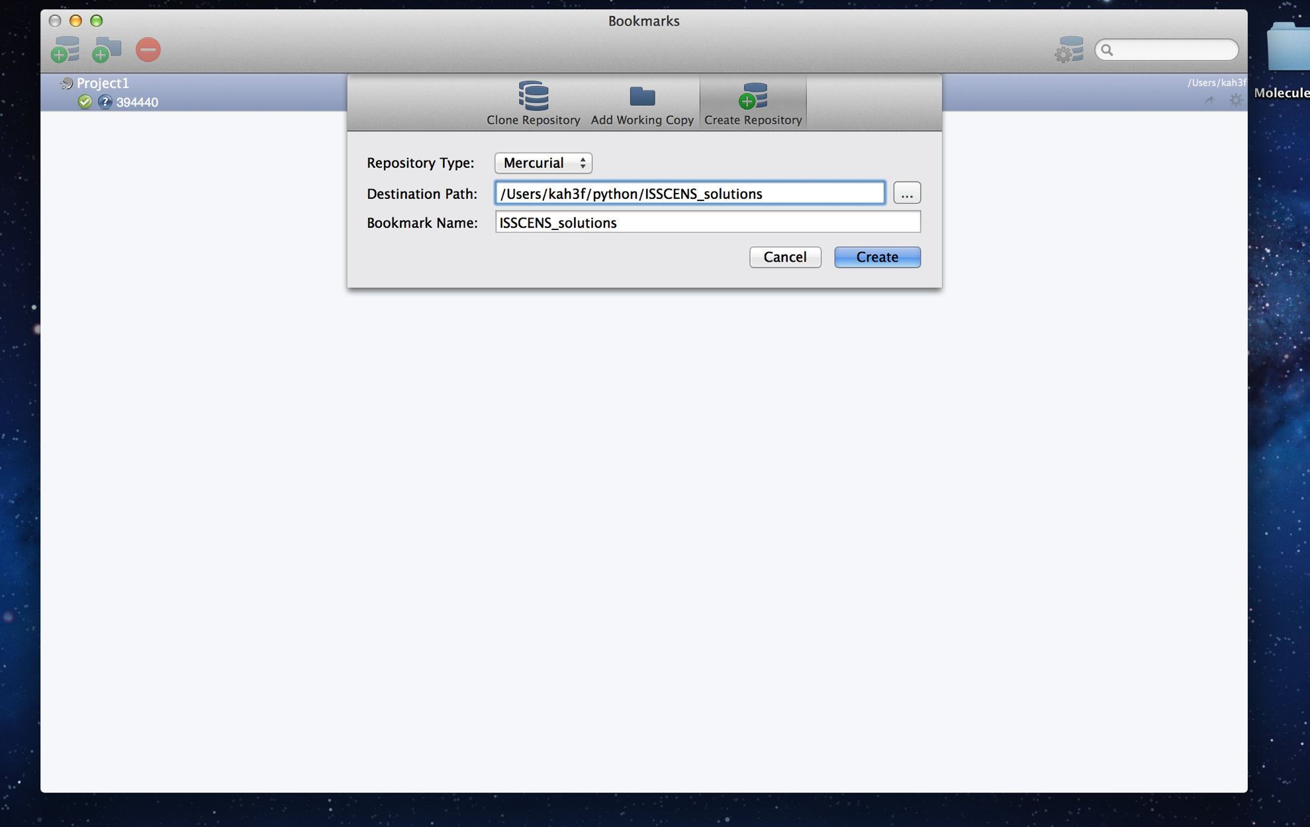
Starting SourceTree (After Free Registration)

Slide 77
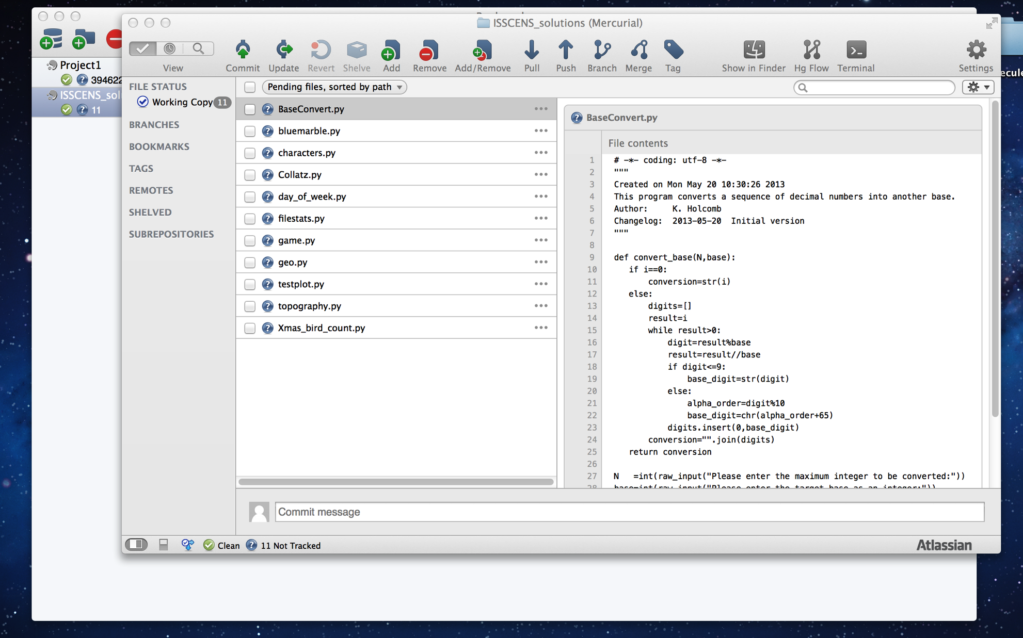
Creating a Repository

Slide 78
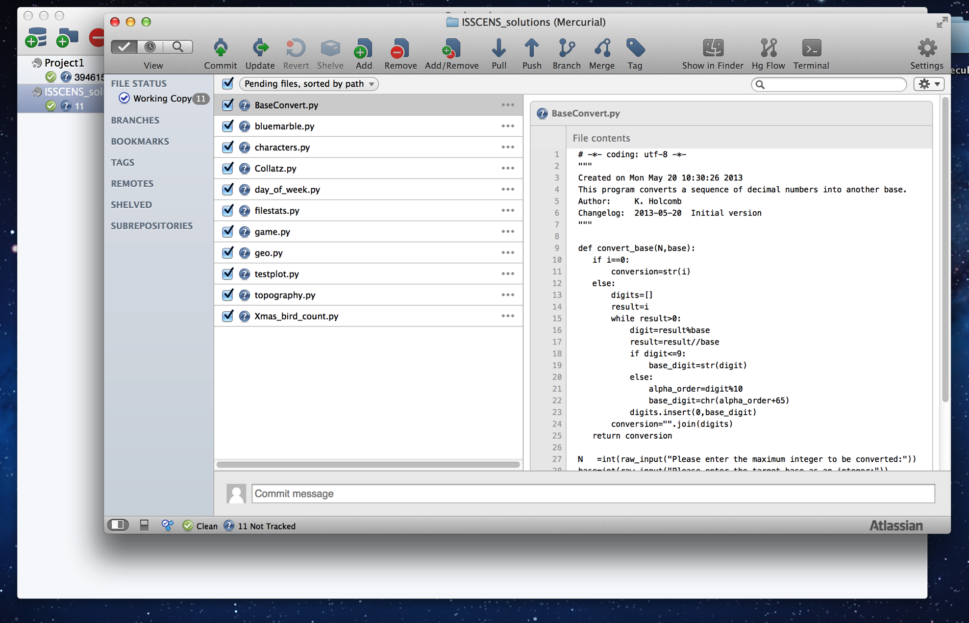
Select Files to Add

Slide 79
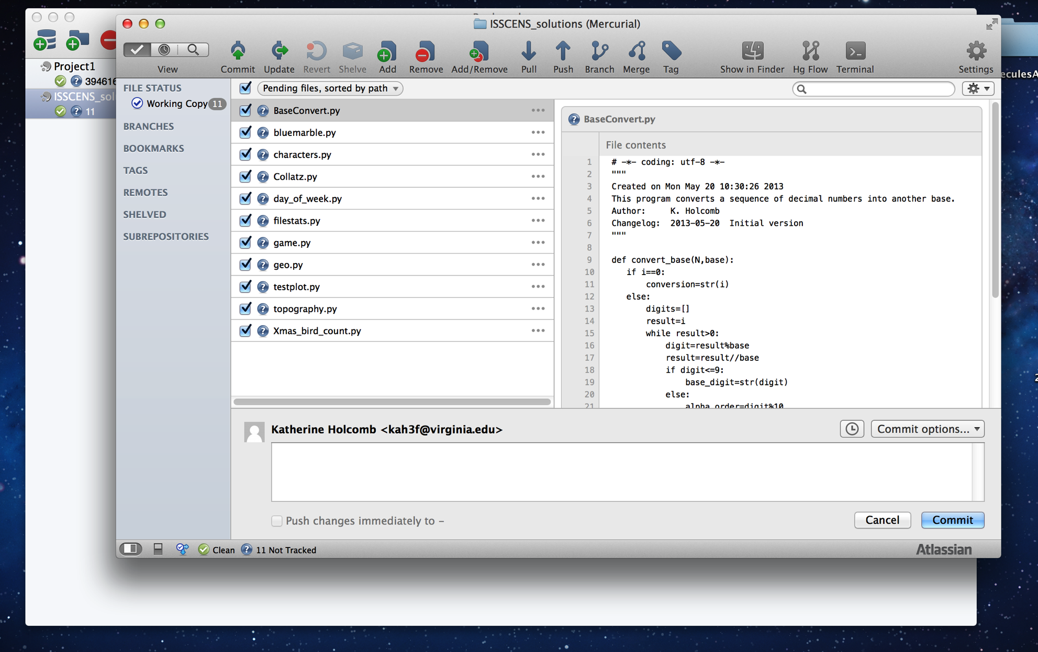
Commit

Slide 80
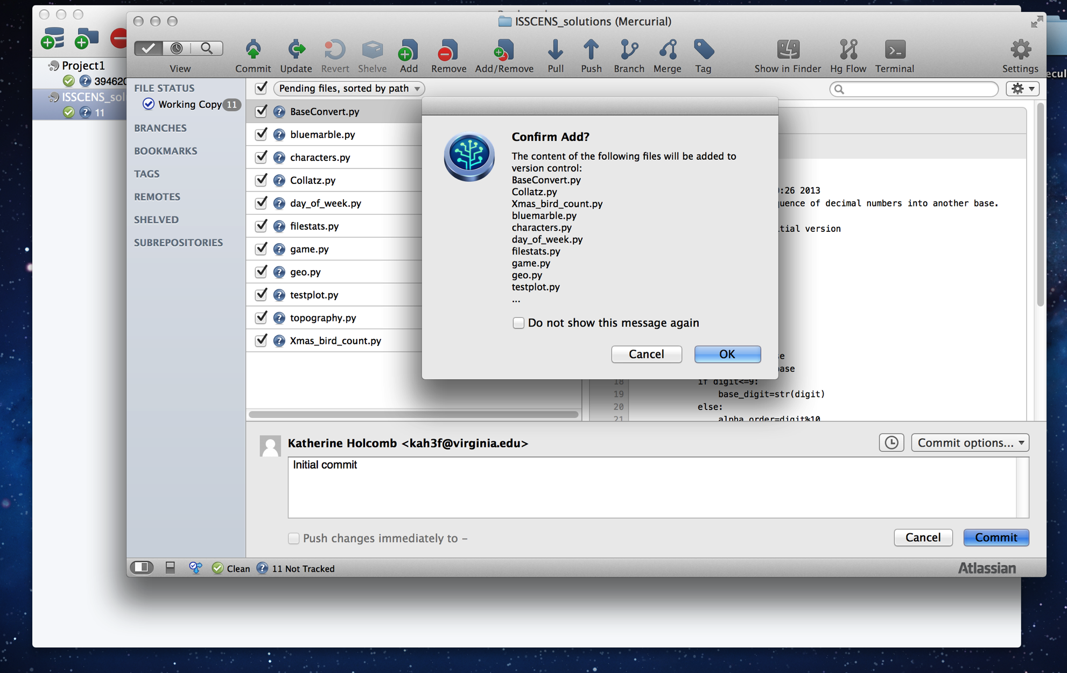
Finalizing the Repository

Slide 81
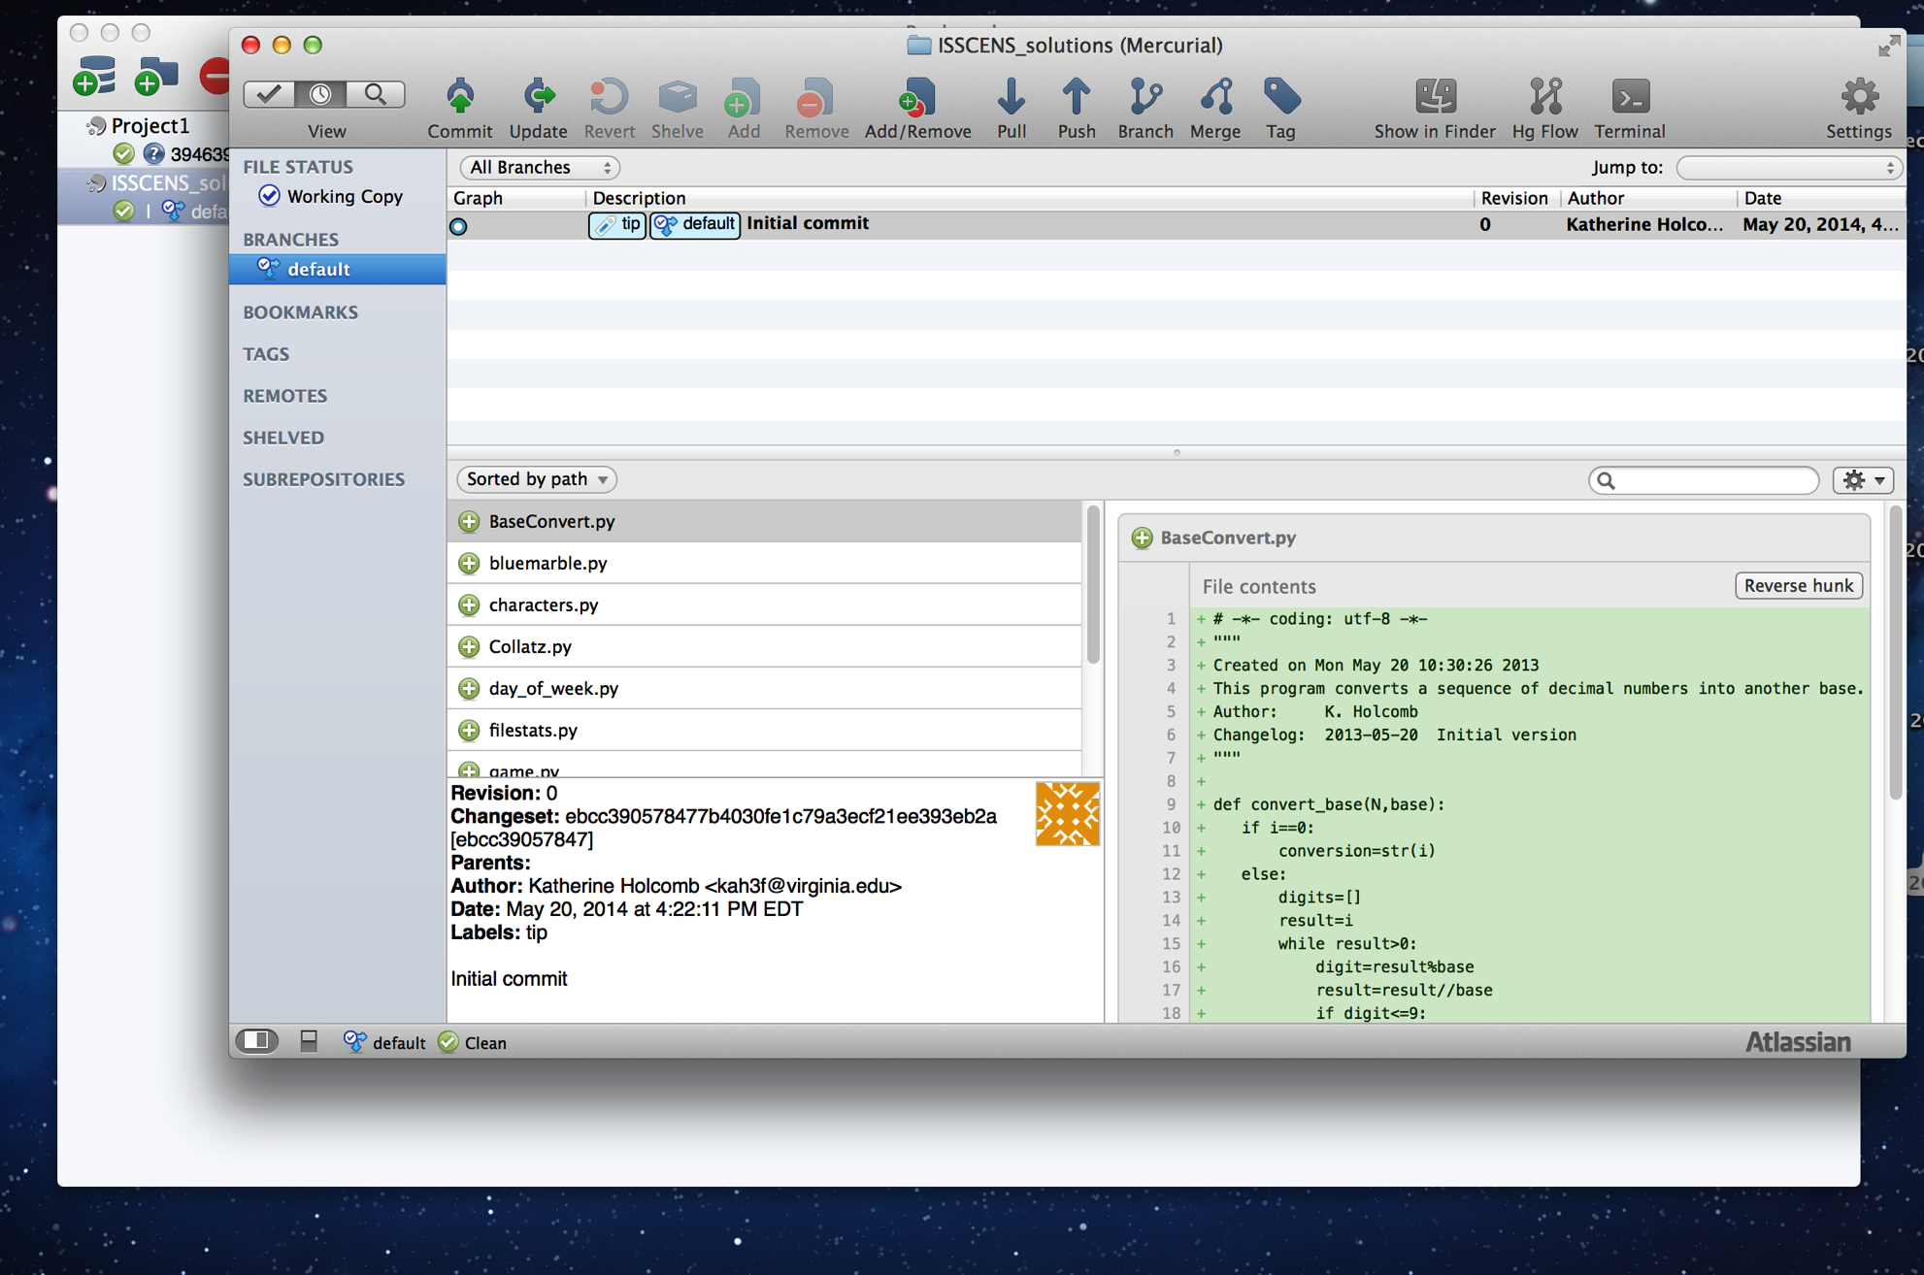
History and File Display

Slide 82
Adding and Committing
We only want to add the source file .py to be tracked.
Don’t track .pyc (Python bytecode).
Don't track .o or .obj (compiled-language object files) or binaries.
When you create a new source file you will add it in the same way.
When we make a change, we commit the new version to the repository.
The file must be committed in order to complete the addition to the repository.
If you use BitBucket or GitHub you then push to the remote repository.

Slide 83
Checking Out
If you want to download from a remote Git repository use git pull
To start fresh from a repository use git clone
Local repositories do not generally require checkouts in Git (since they are local).

Slide 84
Branching
Git can branch source trees
You can create a branch for your own personal work.
Example: You clone the forest model to add bark beetles for your dissertation work.
This may or may not be something that will be rolled back into the main model source.

Slide 85
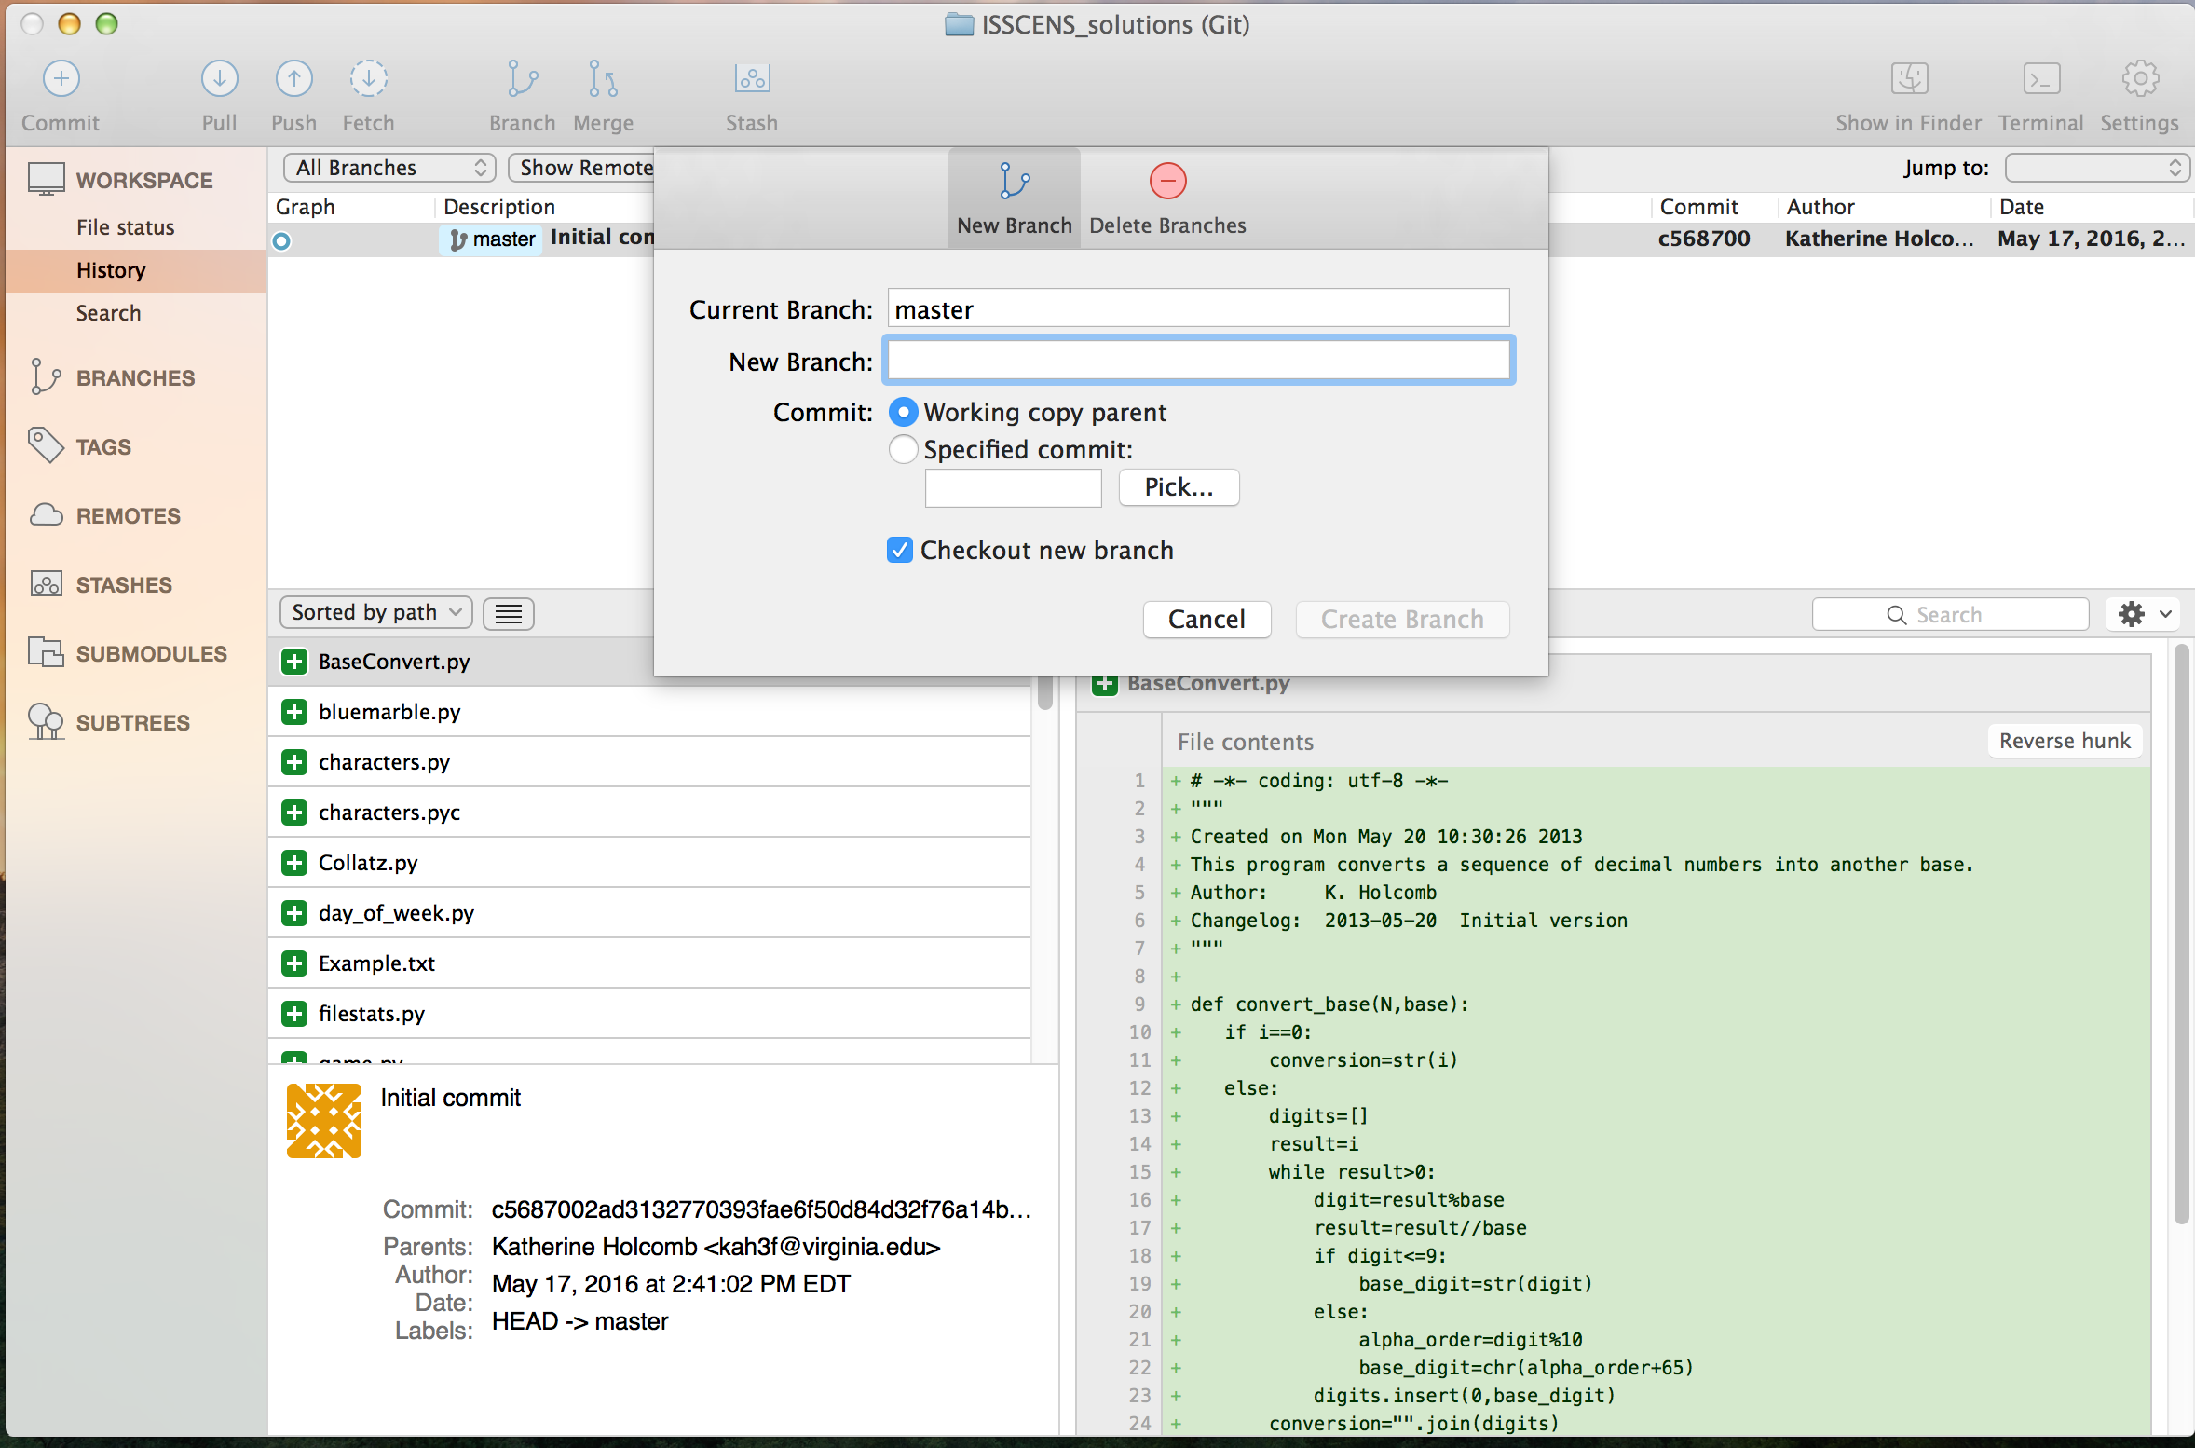
Creating a Branch in SourceTree

Slide 86
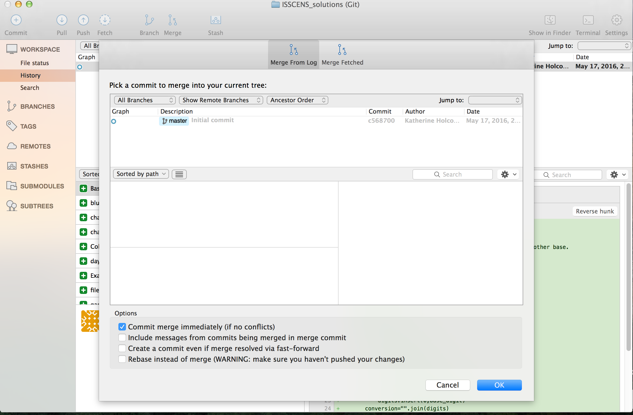
Merging
If multiple people work on a code their changes will have to be merged into the master branch.

Slide 87
Logging on to the cluster

Slide 88
Getting Started
Mac
Open Applications/Utilities/Terminal
Type (all on one line)
scp myuvaid@interactive.hpc.virginia.edu:/share/apps/templates/ fastX_clients/ FastX_MacClient.dmg .
Dot at the end of the line (space between dmg and .)
Windows
Open XMobTerm (or WinSCP or what you have) and set up an scp session
The host is interactive.hpc.virginia.edu
The user ID is your UVA ID, password will be your "Eservices" password
Navigate to /share/apps/templates/fastX_clients. Copy
FastX_WinClient.exe

Slide 89
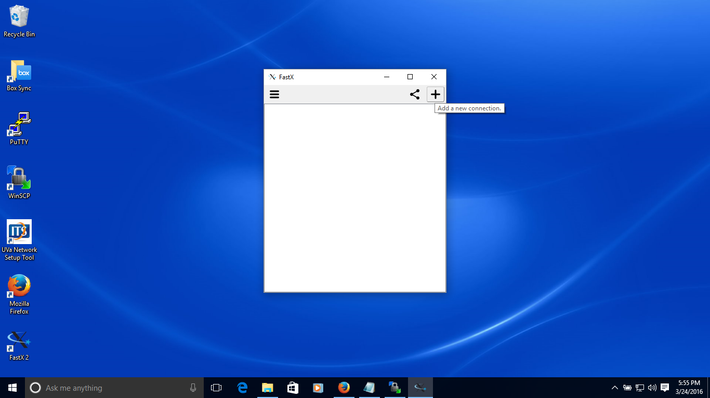
FastX
Install FastX for your OS. Start it up. Add a new connection at the + icon

Slide 90
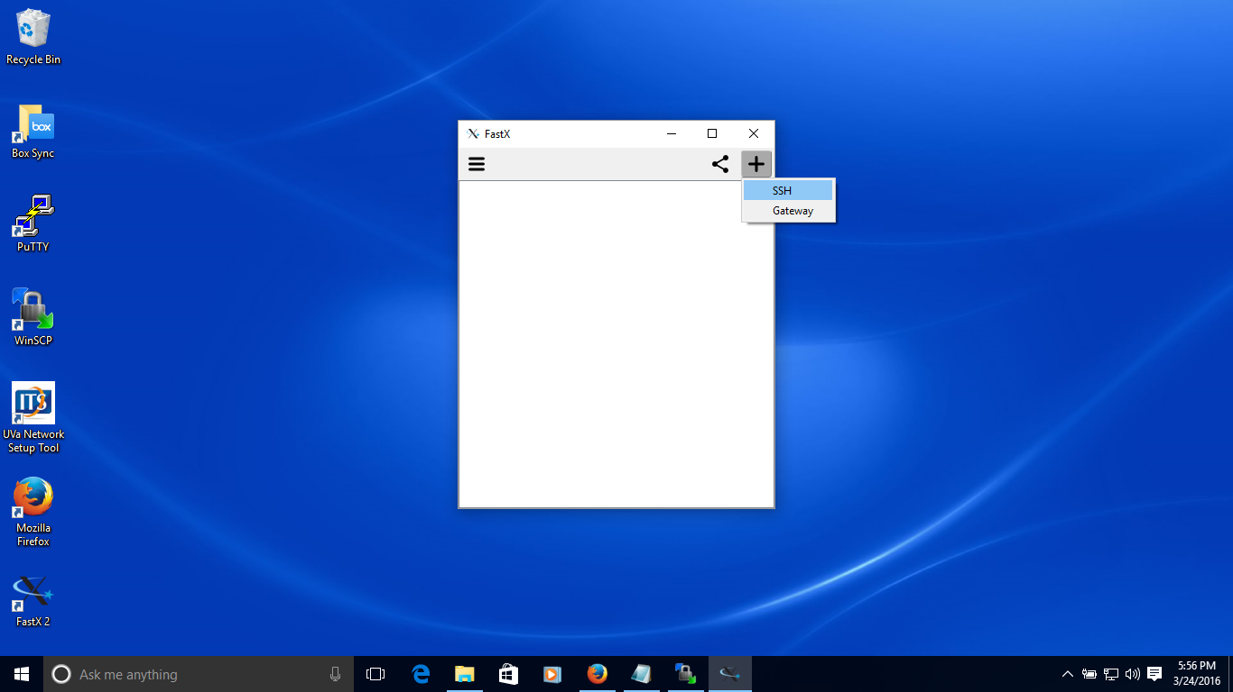
Step 2
Specify an SSH connection

Slide 91
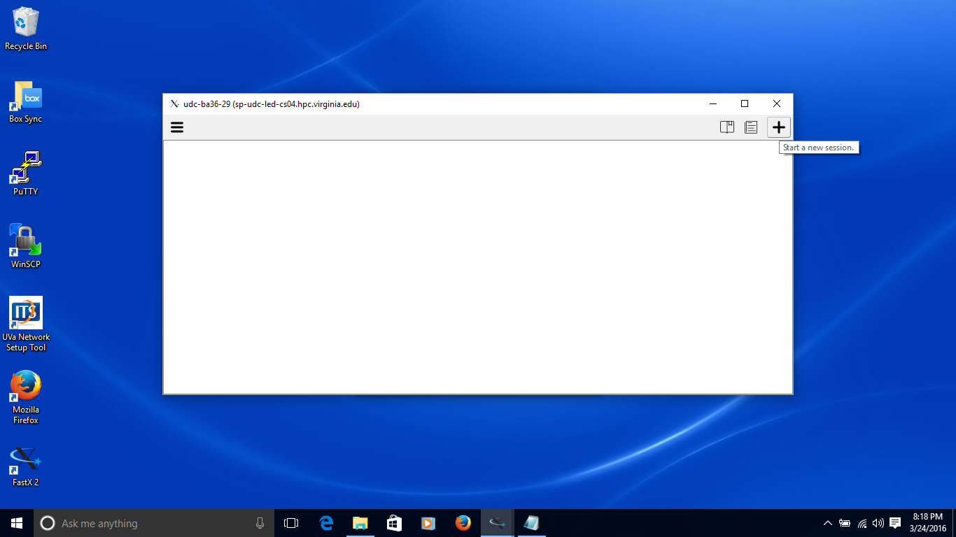
Step 3
Start a new session at the + icon again. Use the host sp-udc-led-cs03.hpc.virginia.edu

Slide 92
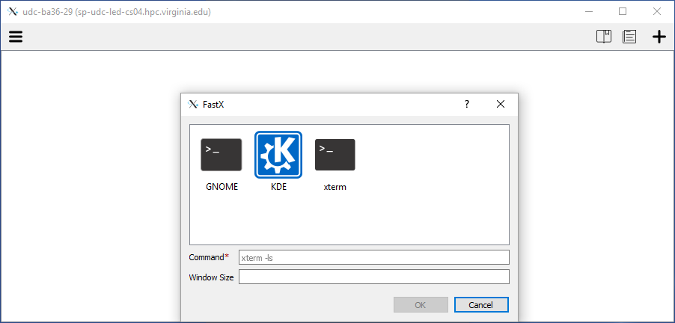
Step 4
Double-click Gnome (or KDE if you know that).

Slide 93
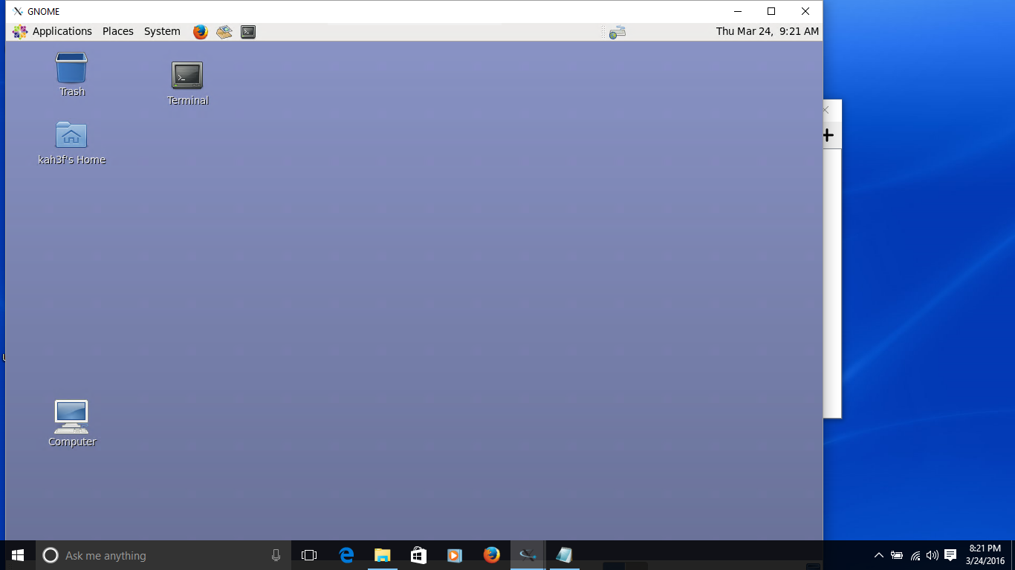
Step 5
Log in. You can resize the remote desktop.

Slide 94
Using the System
Go to Applications->System Tools and open a Terminal. (You can drag the Terminal icon to your desktop if you wish.)
Type
module load geany
Type
geany &
Open a new file
Type
! Program to print hello
! Author: A. Programmer
! Changelog: 20160120 Initial version
print *, 'hello'
print *, 'This is a test'
end

Slide 95
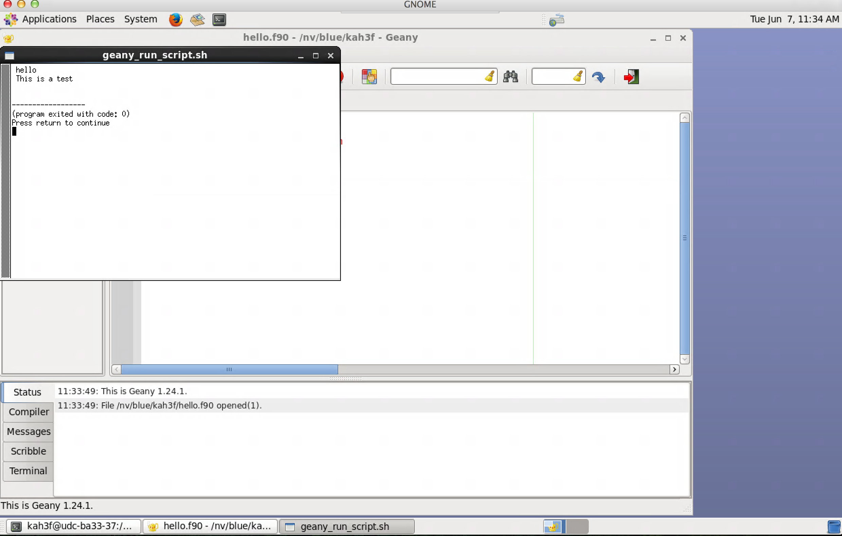
More About Geany
From the menu choose Build->Build
From the menu choose Build->Execute or gears icon. It should pop up a new screen window.

Slide 96
Finishing Up
You will need to dismiss the new window (it will open one each time you run your program)
Quit geany
System->Log Out
Exit FastX

Slide 97
About Geany
Geany is a very simple IDE. More sophisticated IDEs that work for C/C++/Fortran are
Code::Blocks
On cluster as
module load codeblocks
Eclipse
Requires CDT add-on for C/C++
Requires Photran for Fortran (automatically installs CDT as well).

